Slide 1
Use of “HD + OD CP Norm Generator V1.3”
Questions or issues can be sent to David Schreurs at schreurd@uwm.edu/dgschreurs@yahoo.com

Slide 2
Overview
This app is designed to take questions from two preexisting exams and predict the norms for an untested exam built from a subset of those questions.
This is completed using a combination of 2-PL and GPCM IRT models. Following modeling, norms are estimated by feeding Hierarchy GPCM factor scores into Dichotomous IRT parameters and extracting scores using Credit Probability (HD CP). This process is also completed independently by feeding Open GPCM factor scores into Dichotomous IRT parameters and extracting scores using Credit Probability (OD CP).

Slide 3
Table of Contents
Preparing Data
Running the Script
Interpreting Exported Results

Slide 4
Preparing Data
Templates with fictitious data for each of these files is available on my github page.
https://github.com/clapsback/HD-OD-CP-Norm-Generator

Slide 5
Preparing Data
Be default R will import the necessary files as long as they are saved in the same folder as where the script is saved and have the following names:
Old E1.xlsx
Old E2.xlsx
Old E1 Partial Credit.xlsx
Old E2 Partial Credit.xlsx
Question Alignment.xlsx

Slide 6
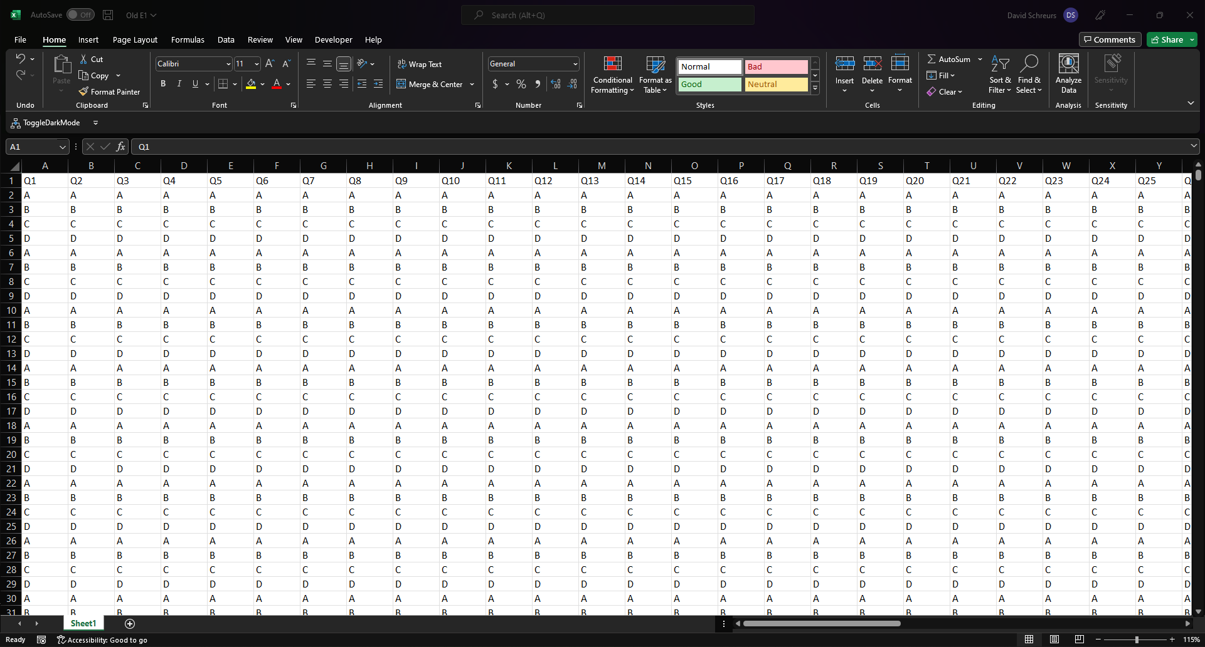
Preparing Data
Old E1.xlsx
This document should contain the letter responses from each student (row) to each question (column) on one of the “old” exam which you are extracting questions from. The first row should be the question number with all other cells being letter responses. Any cells that do not contain “A”, “B”, “C”, or “D” will be treated as missing responses. Lowercase letters will be accepted and capitalized.
Sample Data

Slide 7
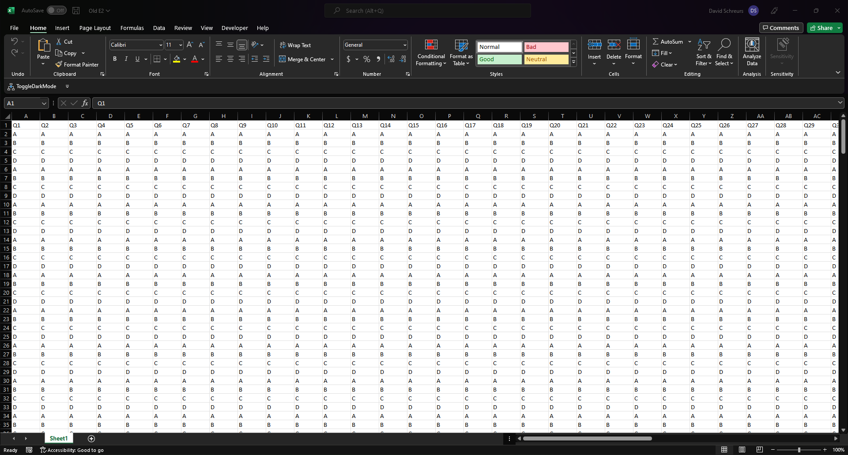
Preparing Data
Old E2.xlsx
This document should contain the letter responses from each student (row) to each question (column) on the second “old” exam which you are extracting questions from. The first row should be the question number with all other cells being letter responses. Any cells that do not contain “A”, “B”, “C”, or “D” will be treated as missing responses. Lowercase letters will be accepted and capitalized.
Sample Data

Slide 8
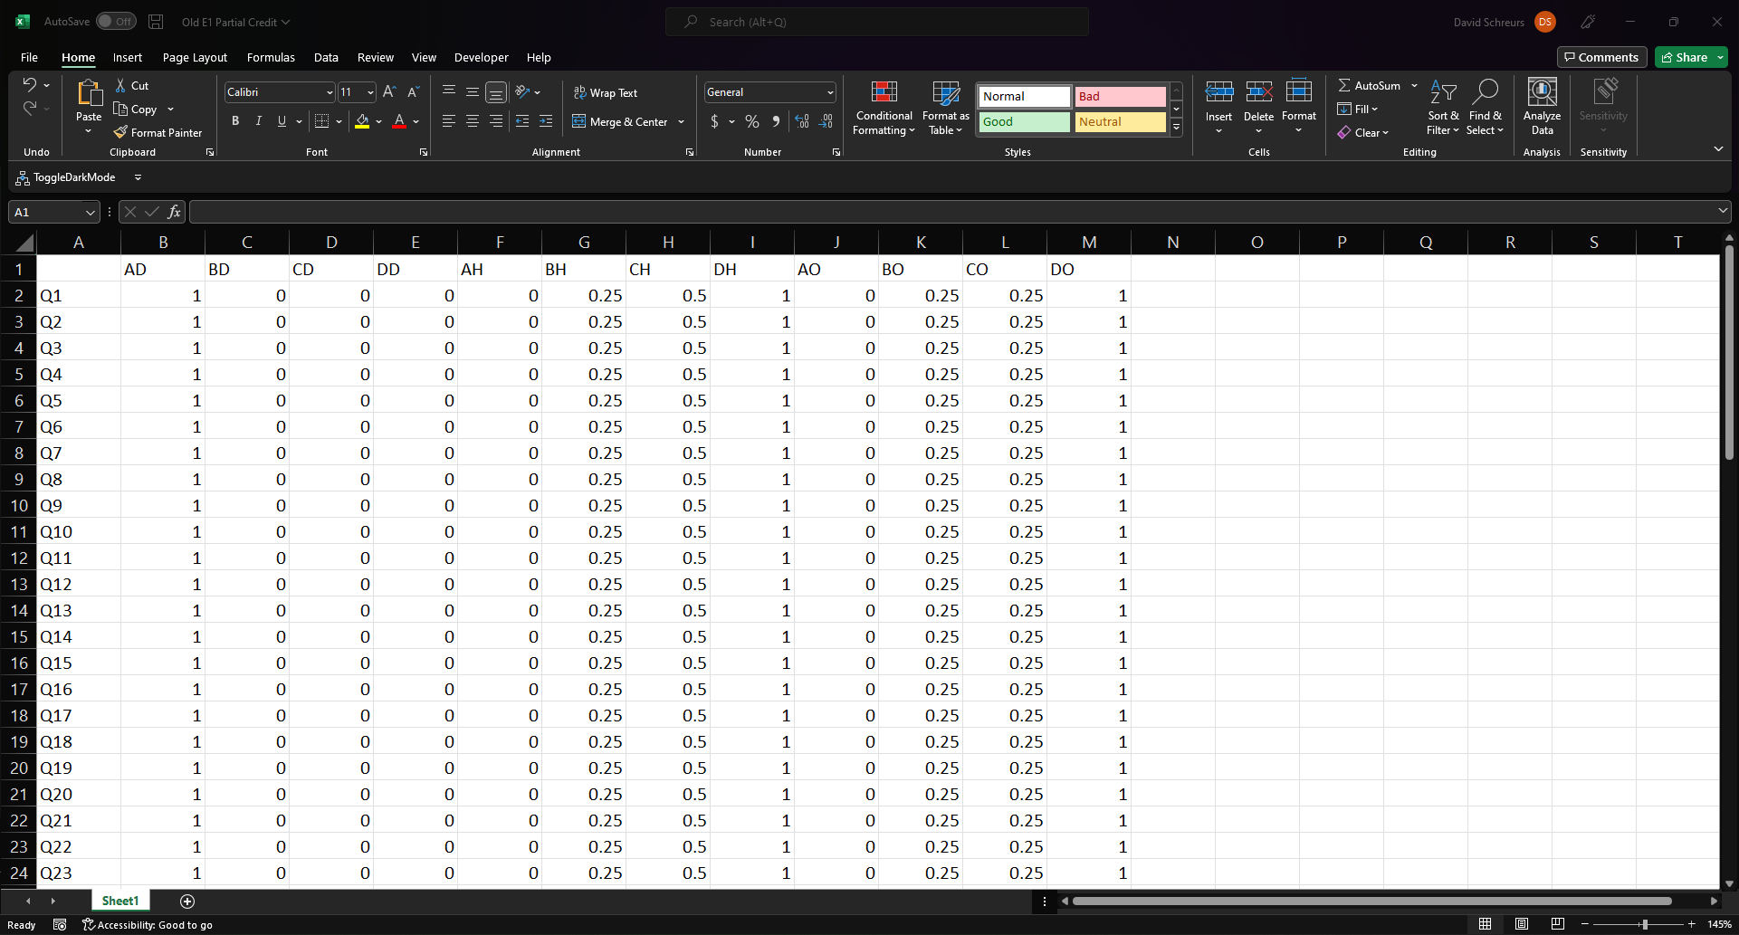
Preparing Data
Old E1 Partial Credit.xlsx
This document should contain the credit to be awarded to each question (row) for each letter response and credit assignment technique (column). The first column should contain the question number which must match the column headings used in “Old E1.xlsx”. The first row must contain the headings shown to the right (“”, AD, BD, CD, DD, AH, BH, CH, DH, AO, BO, CO, DO).
CONTINUED INFORMATION ON NEXT SLIDE
Sample Data

Slide 9
Preparing Data
Old E1 Partial Credit.xlsx
In the first row, the column headings indicate first the letter response, and then the scoring method (Dichotomous, Hierarchy, Open).
Examples
Cell B1 shows that letter A, when scored Dichotomously, is marked correct (1).
Cell C1 shows that letter B, when scored Dichotomously, is marked incorrect (0).
Cell H1 shows that letter C, when scored Hierarchically, is given 0.25 points of partial credit.
Cell M1 shows that letter D, when scored Openly, is given full credit (1).
Sample Data

Slide 10

Preparing Data
Old E2 Partial Credit.xlsx
This document should contain the credit to be awarded to each question (row) for each letter response and credit assignment technique (column). The first column should contain the question number which must match the column headings used in “Old E2.xlsx”. The first row must contain the headings shown to the right (“”, AD, BD, CD, DD, AH, BH, CH, DH, AO, BO, CO, DO).
CONTINUED INFORMATION ON NEXT SLIDE
Sample Data

Slide 11
Preparing Data
Old E2 Partial Credit.xlsx
In the first row, the column headings indicate first the letter response, and then the scoring method (Dichotomous, Hierarchy, Open).
Examples
Cell B1 shows that letter A, when scored Dichotomously, is marked correct (1).
Cell C1 shows that letter B, when scored Dichotomously, is marked incorrect (0).
Cell H1 shows that letter C, when scored Hierarchically, is given 0.25 points of partial credit.
Cell M1 shows that letter D, when scored Openly, is given full credit (1).
Sample Data

Slide 12
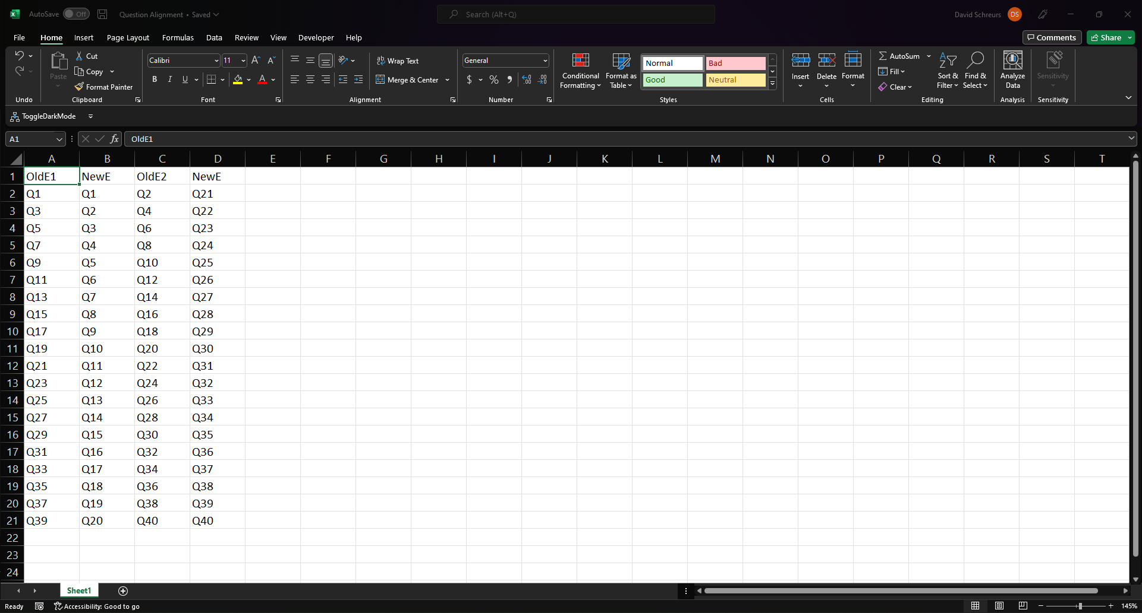
Preparing Data
Question Alignment.xlsx
This document specifies which questions from the old exams you wish to include on the new exam. The question numbers in column A must match the question heading specified in “Old E1.xlsx”. The question numbers in column C must match the question heading specified in “Old E2.xlsx”.
Sample Data

Slide 13
Running the Script
If this is the first time running the script on this computer, install the necessary packages by running these lines of code in the R console
install.packages(“ltm”)
install.packages(“plyr”)
install.packages(“readxl”)
install.packages(“openxlsx”)
install.packages(“irtoys”)
install.packages(“tidyr”)
install.packages(“mirt”)

Slide 14
Running the Script
Assuming the excel files have been named, formatted, and saved correctly in the same directory that the R script is saved in, the code is ready to be run.
Ctrl + Enter can be used to run each line of code
Ctrl + A (to select all), followed by Ctrl + Enter can be used to run the entire code

Slide 15
Running the Script
After the complete code has been run, a new folder with results will be created in the same directory as where the R script is saved. This folder will be named “R Exported”.

Slide 16
Interpreting Exported Results
Within the “R Exported” folder, the most important fille will be a document named “Results.xlsx”. This document contains five tabs
Norms Using DO
Norms Using DH
Partial Exam Norms
Imported Old E1
Imported Old E2

Slide 17
Interpreting Exported Results
Norms Using DO
These are the results predicted when using 2-PL parameters based on the Dichotomous data. And feeding into it the GPCM factor scores based on modeling the Open data.
The tab contains
Column A: The scores which are predicted to occur on the new test
Column B: For each score, the percent of students who are predicted to receive that score
Column C: For each score, the predicted percentile
Column E-N: A norm plot based on the percentages in Column B
Column P-Q: Stats pertaining to the modeled exam
Column S: Scores predicted by the model for each of the students (ordered from highest to lowest)

Slide 18
Interpreting Exported Results
Norms Using DH
These are the results predicted when using 2-PL parameters based on the Dichotomous data. And feeding into it the GPCM factor scores based on modeling the Hierarchy data.
The tab contains
Column A: The scores which are predicted to occur on the new test
Column B: For each score, the percent of students who are predicted to receive that score
Column C: For each score, the predicted percentile
Column E-N: A norm plot based on the percentages in Column B
Column P-Q: Stats pertaining to the modeled exam
Column S: Scores predicted by the model for each of the students (ordered from highest to lowest)

Slide 19
Interpreting Exported Results
Partial Exam Norms
This tab allows for a quick view of how well the IRT methods match the data from the old exams. Using only the questions from the old exams which will be used on the new exam, this plot answers how do the observed and modeled norms compare for the relevant questions. Ideally, the black, red, and blue lines should be very similar.

Slide 20
Interpreting Exported Results
Imported Old E1
This tab contains a verbatim copy of the data imported in “Old E1.xlsx”. This is included to preserve the data which was used in the analysis and to pull relevant questions if item stats need to be calculated

Slide 21
Interpreting Exported Results
Imported Old E2
This tab contains a verbatim copy of the data imported in “Old E2.xlsx”. This is included to preserve the data which was used in the analysis and to pull relevant questions if item stats need to be calculated

